Slide 1

AI based Financial Advisor using Cloud
SRM INSTITUTE OF SCIENCE AND TECHNOLOGY
SCHOOL OF COMPUTING
DEPARTMENT OF COMPUTING TECHNOLOGIES
18CSP107L / 18CSP108L MINOR PROJECT / INTERNSHIP
31/8/2024
First Review
Guide Name Student Name & Registration Number:
Mrs. Vijayalakshmi V Rachit Sood [RA2111028010110]
Assistant Professor Papai Mondal [RA2111028010116]
NWC Asmi Shrivastava [RA2111028010119]

Slide 2
Abstract
Utilizes AI algorithms deployed on cloud infrastructure to provide comprehensive financial advisory services, including portfolio management and investment strategies.
Manages and optimizes stock investments, fixed deposits, and other financial assets with real-time analytics and predictive insights.
Offers personalized financial consulting based on user data and market trends, ensuring tailored advice for individual financial goals.
Integrates basic banking functions to streamline transactions, account management, and financial planning within a unified platform.
Ensures secure, scalable, and accessible financial solutions through cloud-based technology, enhancing user experience and system reliability.

Slide 3
Introduction
Harnessing advanced AI algorithms, this cloud-based financial advisor offers seamless management of stocks, investments, and fixed deposits.
It provides real-time financial consulting and personalized advice, leveraging data-driven insights to optimize investment strategies.
Integrated with basic banking services, it simplifies financial transactions and account management for users.
The system ensures high security and scalability, handling large volumes of financial data with robust cloud infrastructure.
Users benefit from automated recommendations and analytics, enhancing decision-making and financial planning efficiency.

Slide 4
Problem Statement
Current financial advisory services lack real-time, personalized recommendations, leading to suboptimal investment decisions and missed opportunities.
Traditional financial management methods are often inefficient, relying on manual updates and static data analysis that can delay critical financial decisions.
Managing diverse financial assets, such as stocks, investments, and fixed deposits, requires integrated solutions that seamlessly track and optimize each category.
Basic banking needs are often disconnected from investment strategies, causing inefficiencies in financial planning and resource allocation.
Access to consistent, expert financial consulting is limited, making it challenging for individuals to receive tailored advice and guidance on complex financial matters.

Slide 5
Objectives
Provide real-time analysis and recommendations for stock investments to optimize portfolio performance.
Manage and track fixed deposits, ensuring optimal interest rates and timely renewals.
Offer personalized investment strategies based on user financial goals and risk tolerance.
Facilitate basic banking operations through integrated cloud-based services for seamless user experience.
Deliver expert financial consulting to guide users in making informed decisions on investments and savings.

Slide 6
Literature Review
S. No | Title (Name of the journal, author and publication details) | Methodology (Provide a Summary of key studies and their findings) | Identification of gaps and limitations. (Identify the limitations of the Research Paper)
1 | P. Pangavhane, S. Kolse, P. Avhad, T. Gadekar, N. K. Darwante and S. V. Chaudhari, "Transforming Finance Through Automation Using AI-Driven Personal Finance Advisors," 2023 4th International Conference on Computation, Automation and Knowledge Management (ICCAKM), Dubai, United Arab Emirates, 2023, pp. 1-5 | Highlights complexity of modern finance Integration of AI for decision-making. discusses overall well-being with AI- powered advisors. | May lack privacy concerns Doesn’t provide a transparent deployment framework. Can struggle with widespread adoption.
2 | Manchuna Shanmuganathan, Behavioural finance in an era of artificial intelligence: Longitudinal case study of robo-advisors in investment decisions, Journal of Behavioral and Experimental Finance,Volume 27,2020,100297,ISSN 2214-6350, | Behavioural finance with AI Development of AI with respect to finance Robo-Advisors for decision making in Finance | May lack understanding of AI algorithms. capture less market that is behaviour finance. Doesn’t provide a solution for large databases.
3 | Artificial Intelligence in Financial Services: Customer Chatbot Advisor Adoption by Kanchan Patil, Mugdha S Kulkarni. International Journal of Innovative Technology and Exploring Engineering (IJITEE) ISSN: 2278-3075, Volume-9 Issue-1, November 2019 | Chatbot advisor services in financial sectors Impact of AI on customer engagement using financial services. Key factors include usefulness, ease of use, privacy, and risk. | Long-term adoption trends or changes in tech not considered Limited geographic scope, focused only in Pune does’nt generalize findings. Security and privacy risks not fully explored.

Slide 7
4. | A Review on the role of Robo-advisory service in transforming Personal Finance in the Digital -Era-Priyanka R Rao Journal of Informatics Education and Research ISSN: 1526-4726 Vol 4 Issue 2(2024) | Fintech innovation is changing personal finance in the world. AI being used to provide user friendly means to financial advisory.. It includes how AI has changed and emphasized fintech innovations. | It is not cost-effective. There are regulatory issues No proper management of data collection.
5. | L. Alsmadi, E. Al-Amayreh, J. Kasem and A. S. Al-Gasaymeh, "Impact of Robo-advisors and Artificial Intelligence on Customer Service Performance at Personal Finance Industry," 2023 International Conference on Business Analytics for Technology and Security (ICBATS), Dubai, United Arab Emirates, 2023 | impact of the financial sector in decision-making. It deals with customer satisfaction in order to implement AI Sample data of 166 employees used for data analysis | Very less data for research. Doesn’t deal with performance. Not a proper goal other than customer satisfaction.
6. | FinAID, A Financial Advisor Application using AI by Ashish Shah, Pratik Raj, Pushpam Kumar, Supriya P, Asha H V, International Journal of Recent Technology and Engineering (IJRTE) ISSN: 2277-3878, Volume-9 Issue-1, May 2020 | Highlights the high costs of traditional financial advisors, which can range from $1K to $3k. Emphasize the need for new service designs in the financial sector. tells the role of financial advisors in tracking market fluctuations. | Limited Scope of used Plaid API(not available for India etc.) Accuracy of predictions from AI and ML models may be limited. Concerns about data security and privacy are not fully addressed.
7. | Implementing artificial intelligence empowered financial advisory services: A literature review and critical research agenda Hui Zhu , Olli Vigren , Inga-Lill Soderberg, Journal of Business Research Volume 174 , March 2024, 114494 | Assesses and summarizes what we know about using service robots in financial advisory services. shows a framework for robo-advisory services with parts customer features, ethical, legal, and regulatory frameworks. findings compare these parts to the original framework by Belanche et al. | Some important concepts are missing from earlier framework, like: “Organizational challenges in using robo-advisors” (Rasiwala & Kohli, 2021). “How other people’s opinions can influence attitudes towards robo-advisors” (Belanche et al., 2019).

Slide 8
8. | V. Pandey, Wee-Keong Ng and Ee-Peng Lim, "Financial advisor agent in a multi-agent financial trading system," Proceedings 11th International Workshop on Database and Expert Systems Applications, London, UK, 2000, pp. 482-486, doi: 10.1109/DEXA.2000.875070. | shows advancements in financial systems using Multi-Agent Financial Trading System(MAFTS). monitored stock prices and analyzed market data, according to user-defined criteria. Paper compares MAFTS with other systems like the Quo Vadis system, which integrates data mining and soft-computing. | Current agents have limited capabilities and don’t incorporate NN or fuzzy. Focuses mainly on technical analysis. Depends on specific, possibly costly data sources like Routers
9. | Galena Pisoni, Natalia Díaz-Rodríguez, Responsible and human centric AI-based insurance advisors,Information Processing & Management, Volume 60, Issue 3,2023,103273,ISSN 0306-4573 | It takes review from existing literature to understand specifications. It covers different types of data to develop systems. It emphasizes being transparent and user friendly. | Lack of clear guidelines and regulatory frameworks. Data privacy and security is also a challenge. limited strategies to build user trust.
10. | Zhang, L., Pentina, I. and Fan, Y. (2021), "Who do you choose? Comparing perceptions of human vs robo-advisor in the context of financial services", Journal of Services Marketing, Vol. 35 No. 5, pp. 634-646. | Case study to find out which is a better human or AI financial advisor. It helps to identify differences in consumers’ perceptions of trust. It helps to know that users prefer highly expert humans over robo-advisors. | It doesn’t consider potential variations of AI study doesn’t represent diversity of users. It captures immediate perceptions rather than long-term.
11. | Driggs, R. (2023). Man vs. Machine: The Future of Financial Advising. Finance Undergraduate Honors Theses, University of Arkansas, Fayetteville | Concluded many advisors lack succession plans, impacting future client base. Analysed Technologies like GPT-4 showing its significant progress in finance. survey finds that only 15% of participants would trust an AI with assets & wouldn’t prefer an AI over a human advisor. | The research assumes AI will reach higher proficiency than human financial advisors. Survey included only 100 people that was over social-media. focuses on current AI capabilities only and doesn’t fully explore future advancements.

Slide 9
12. | Bhatia, A., Chandani, A., Atiq, R., Mehta, M. and Divekar, R. (2021), "Artificial intelligence in financial services: a qualitative research to discover robo-advisory services", Qualitative Research in Financial Markets, Vol. 13 No. 5, pp. 632-654 | It conducted 5 focused group discussions with active indian stock market investors. They analyzed discussions and helped them to know about key factors of their perceptions. It included cost-effectiveness,trust,data security. | Not a generalized study as it includes less people. Lacks future developments of AI. More detailed programming and backend is needed.
13 | M. -Y. Day, J. -T. Lin and Y. -C. Chen, "Artificial Intelligence for Conversational Robo-Advisor," 2018 IEEE/ACM International Conference on Advances in Social Networks Analysis and Mining (ASONAM), Barcelona, Spain, 2018, pp. 1057-1064, doi: 10.1109/ASONAM.2018.8508269. | It uses LSTM models to predict performance of investment targets. Models are compared to determine which provides the best investment portfolio. It integrates AIML and generative model to develop robo-advisor. | Limited investigation on deep learning. Research is constrained only to Taiwan.. It lacks in providing detail evaluation of user experience and effectiveness.
14 | Can LLMs be Good Financial Advisors?: An Initial Study in Personal Decision Making for Optimized Outcomes, Kausik Lakkaraju, Sai Krishna Revanth Vuruma, Vishal Pallagani, Bharath Muppasani, Biplav Srivastava, University of South Carolina, cited: arXiv:2307.07422 [cs.CL] | study tested the chatbots in multiple languages, revealing varying levels of effectiveness in handling different linguistic contexts. Chatbots showed limitations in making good recommendations for complex financial decisions. Concluded they’ve critical gaps in providing reliable financial information. | The paper did not dive deep into why chatbots failed. The research was done only with ChatGPT and Bard with a small set of questions. Covered a narrow range of financial scenarios.
15 | Robo-advisors as Automated Personal Financial Planners – SWOT Analysis, Krzysztof Waliszewski, Marta Zięba-Szklarska DOI: 10.18778/2391-6478.3.27.09 License: CC BY-NC-ND 4.0 | SWOT analysis revealed that Robo-Advisors have strengths in reducing costs and making investment services accessible to a wider audience. Concluded that Robo-Advisors are not seen as a threat but rather as a complement to traditional financial advisors. | Poor evaluation of risk tolerance and lack of personalisation. The lack of direct human contact in Robo-Advice platforms can be a drawback.

Slide 10
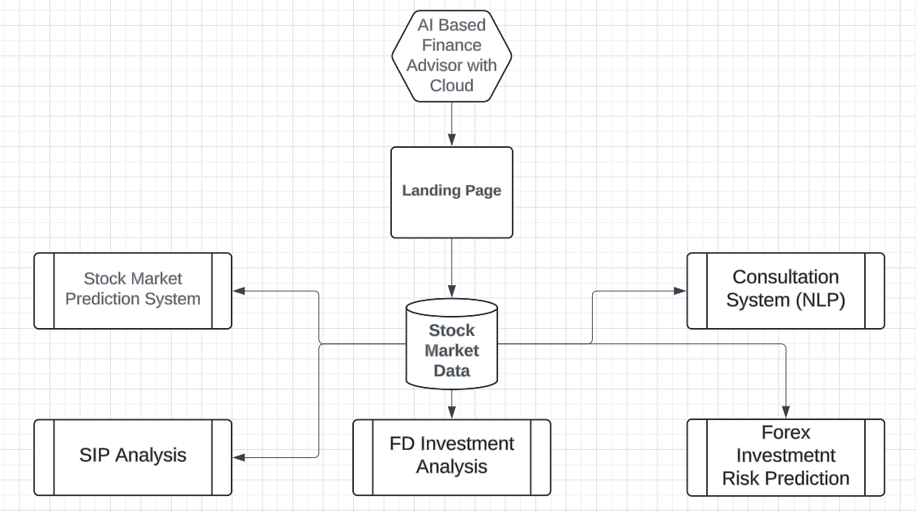
Architecture Diagram

Slide 11
Existing Systems
Current financial advisory systems often lack personalization, offering generic advice that may not align with individual financial goals or risk tolerance.
Many existing systems struggle with real-time data integration, leading to outdated or inaccurate financial recommendations and investment insights.
Security and privacy concerns are prevalent, with inadequate measures to protect sensitive financial information and prevent unauthorized access.
The complexity of managing multiple financial aspects—such as stocks, investments, and fixed deposits—can overwhelm users, leading to fragmented advice and poor financial decisions.
Integration with basic banking services is often limited or non-existent, resulting in disjointed financial management and an incomplete view of one's financial health.

Slide 12
Proposed System / Methodology
Existing systems often rely on manual inputs and static data analysis, leading to slower decision-making and a lack of real-time insights. The AI-based financial advisor will automate data collection and analysis, providing real-time financial insights and recommendations.
Current platforms may offer limited integration across various financial services. The new system will seamlessly integrate stocks, investments, fixed deposits, and basic banking into a unified platform, allowing users to manage all aspects of their finances from a single interface.
Traditional financial advisory tools often lack personalized recommendations. The AI-driven approach will use machine learning to analyze individual financial patterns and goals, delivering tailored investment strategies and personalized financial advice.
Existing solutions might not leverage advanced predictive analytics. The AI-based system will utilize advanced algorithms to forecast market trends and potential risks, enabling proactive adjustments to investment portfolios and financial plans.
Many current systems provide generic financial consulting. The new system will include advanced AI algorithms for in-depth financial consulting, offering actionable insights and strategies based on real-time data and user-specific financial situations.

Slide 13
List of Modules
Landing Page : A responsive webpage, which is the entry point in the website.
Stock Detection with LSTM: Analyze stock tickers with graph followers.
SIP Analysis: Analyze and recommend best SIP installments for growth.
FD Analysis: Best advice for fixed deposits and liquidation of FDs
Investment Prediction: Investment asset analysis and future detection of assets.
Forex & Cognitive Budget: Forex risk prediction and suggestive investment
Consultation System (NLP): Consultations and best practices to reduce risk and mutual fund gains.

Slide 14
References
https://ieeexplore.ieee.org/abstract/document/10147688
https://ieeexplore.ieee.org/abstract/document/10189903
https://ieeexplore.ieee.org/abstract/document/10563756
https://ieeexplore.ieee.org/abstract/document/10117925
https://ieeexplore.ieee.org/abstract/document/10616904
https://ieeexplore.ieee.org/abstract/document/10638924
https://ieeexplore.ieee.org/abstract/document/10307949
https://ieeexplore.ieee.org/abstract/document/10165876
https://ieeexplore.ieee.org/abstract/document/10563564
https://link.springer.com/article/10.1186/s40854-022-00442-6

